Slide 1


Heart Disease Indicators
A Excel Capstone Project by Ritam Sahu.

Slide 2

Objectives
To educate the people about heart disease indicators.
To create a dynamic dashboard based on dataset from Kaggle, after analyse the dataset with various plots and conclusions.

Slide 3

Dataset
Individuals: | 4,00,000
Rows: | 319766
Columns: | 18
Country: | USA
 | Originally, the dataset come from the CDC and is a major part of the Behavioural Risk Factor Surveillance System (BRFSS), which conducts annual telephone surveys to gather data on the health status of U.S. residents. I collected it from Kaggle.com.

Slide 4

Problem Statements
01
02
03
04
05
06
Which age group has the highest incidence of heart disease?
What is the highest BMI among different ages?
What is the smoking and alcohol consumption rate among all?
What is the reason for most women having heart disease?
Is Heart disease associated with higher BMI?
Are diabetic conditions the most common cause of heart disease?
07
08
09
What is the highest BMI among races?
Which races are most affected by heart disease?
Which race and age group consumes the most alcohol and cigarettes?
10
Which races has most diabetic?

Slide 5

Introduction
Heart disease is one of the leading causes of death for people of most races in the US (African Americans, American Indians and Alaska Natives, and white people).
About half of all Americans (47%) have at least 1 of 3 key risk factors for heart disease: high blood pressure, high cholesterol, and smoking. Other key indicator include diabetic status, obesity (high BMI), not getting enough physical activity or drinking too much alcohol.
Detecting the factors that have the greatest impact on heart disease is very important in healthcare.

Slide 6
01
Heart Disease
Which age group has the highest incidence of heart disease?

Slide 7
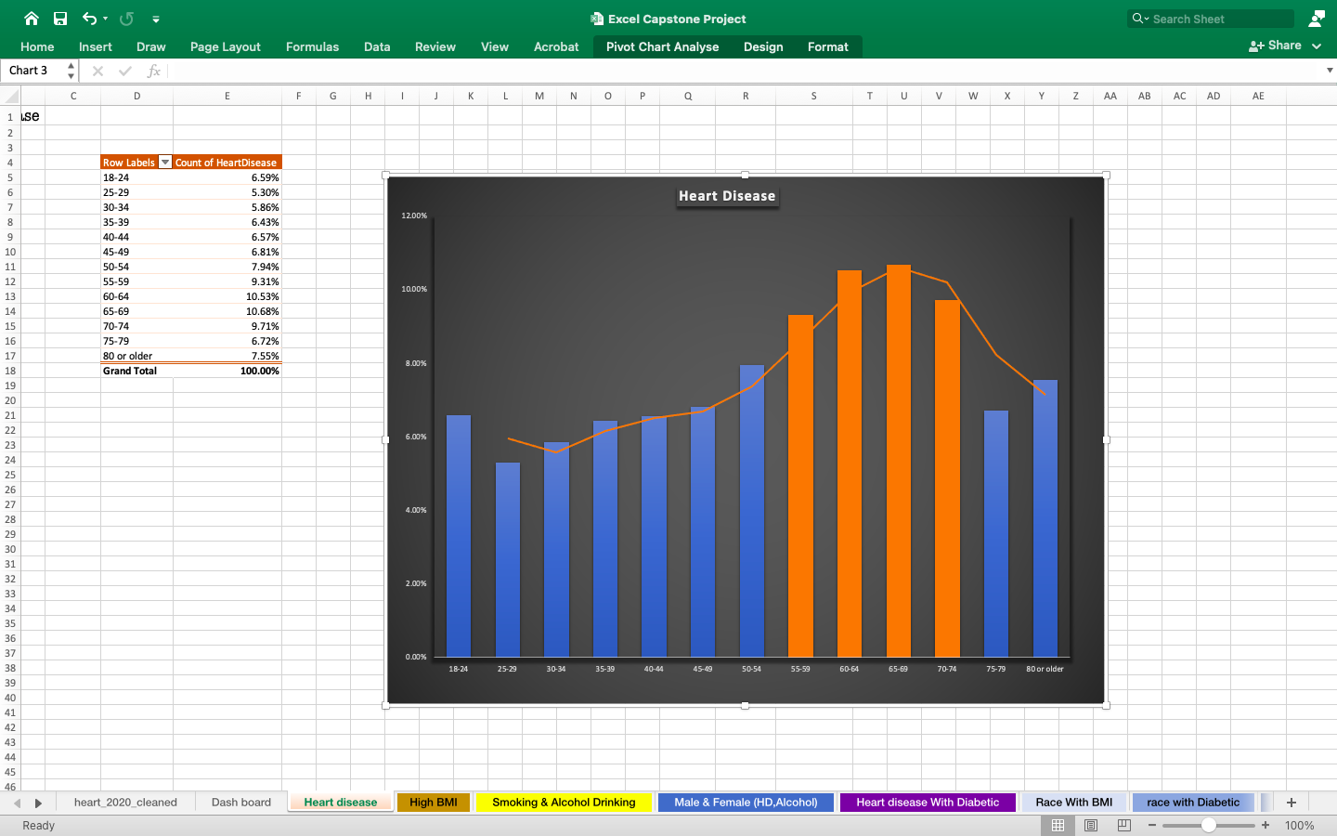
Age wise Heart disease
What age group has the highest incidence of heart disease?

Slide 8
02
BMI
What is the highest BMI among different ages?

Slide 9
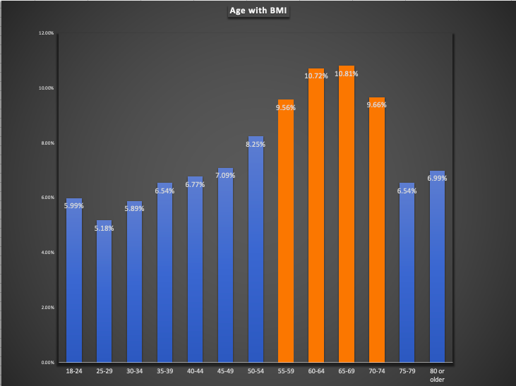
What is the highest BMI among different ages?
BMI is a key factor

Slide 10

Bad Habits
03
What is the smoking and alcohol consumption rate among all?

Slide 11
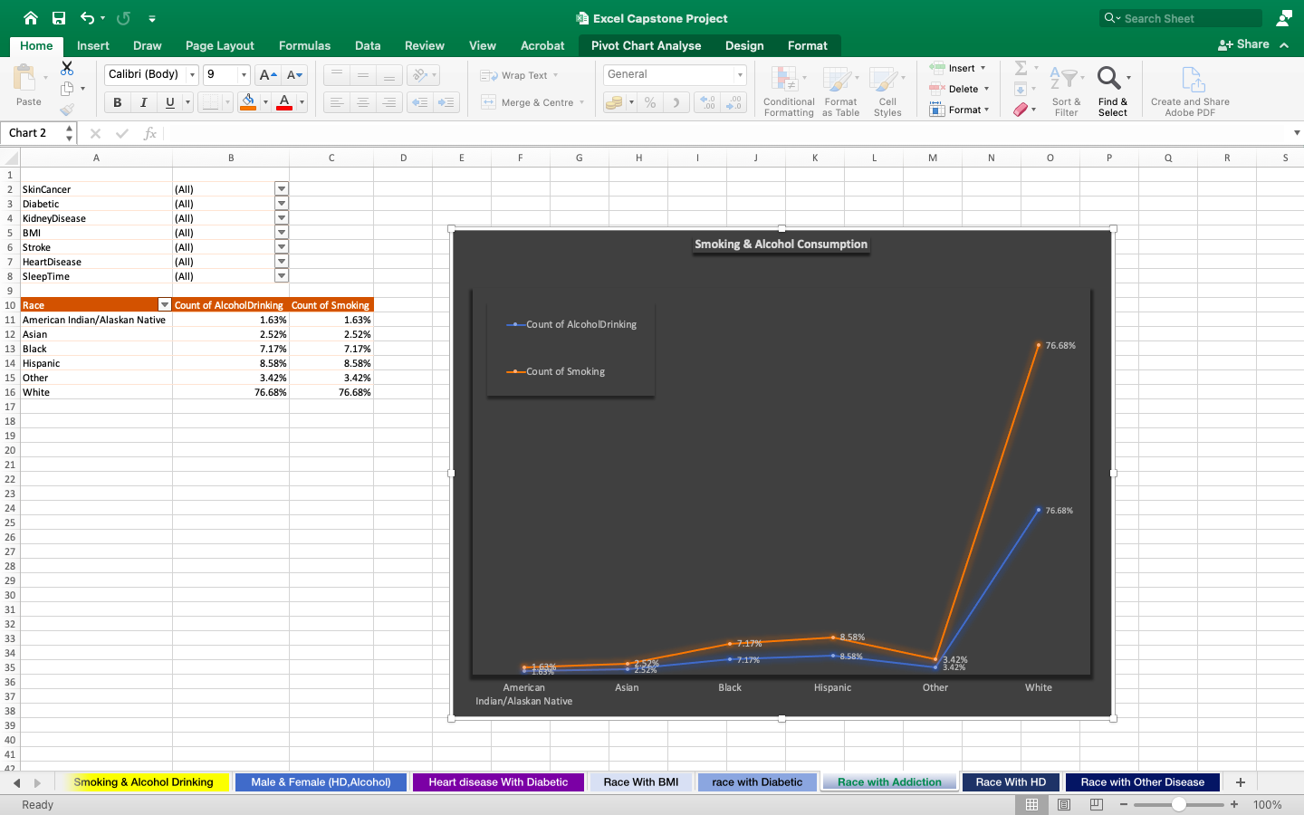
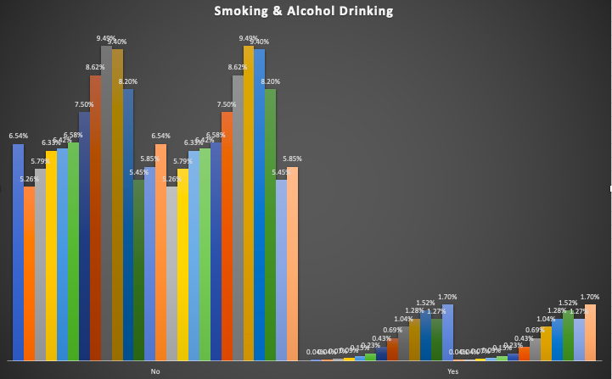
Smoking
Smoking increases heart rate, tightens major arteries, and can cause an irregular heart rhythm, all of which make your heart work harder.
Alcohol
Excessive alcohol intake can lead to high blood pressure, heart failure or stroke.
Smoking & alcohol drinking increases with age.

Slide 12
Females Affected
04
What is the reason for most women having heart disease?

Slide 13

What is the reason for most women having heart disease?
Excessive alcohol intake can lead to high blood pressure, heart failure or stroke.

Slide 14
05
High BMI
Is heart disease associated with higher BMI?

Slide 15
Heart disease is associated with higher BMI?
Age 55-74 shows highest no of heart disease

Slide 16
Diabetic
05
Are diabetic conditions the most common cause of heart disease?

Slide 17
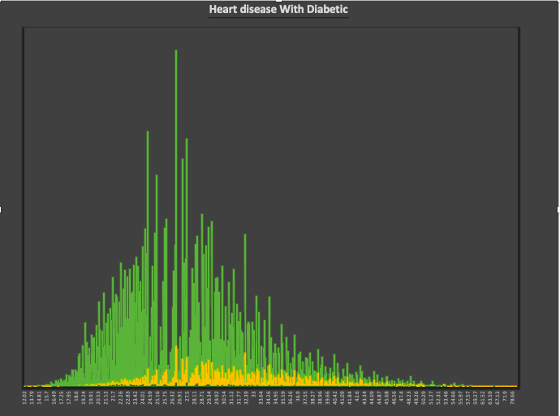
Are diabetic conditions the most common cause of heart disease?
Most affected heart disease persons are diabetic.

Slide 18
07
Races BMI
What is the highest BMI among races?

Slide 19

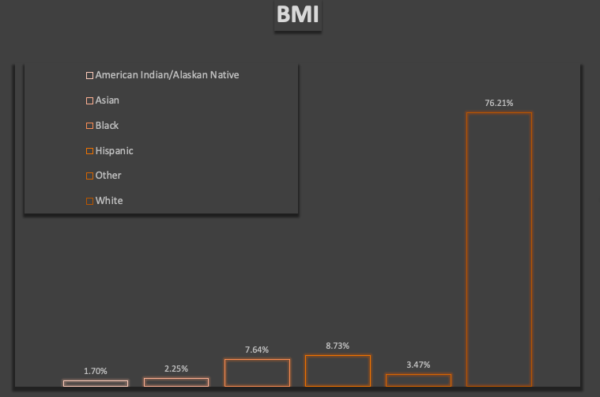
What is the highest BMI among races?

Slide 20
08
Races Heart Disease
Heart disease affects which races the most?

Slide 21
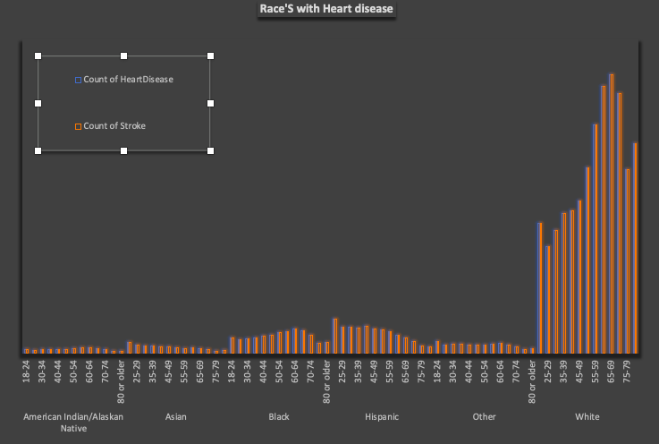
Heart disease affects which races the most?

Slide 22
Races Consumption
09
Which race and age group consumes the most alcohol and cigarettes?

Slide 23
Which race and age group consumes the most alcohol and cigarettes?
Smoking & alcohol drinking increases with age.

Slide 24
10
Diabetic Races
Which races has most diabetic?

Slide 25

Which races has most diabetic?

Slide 26
DASHBOARD

Slide 27
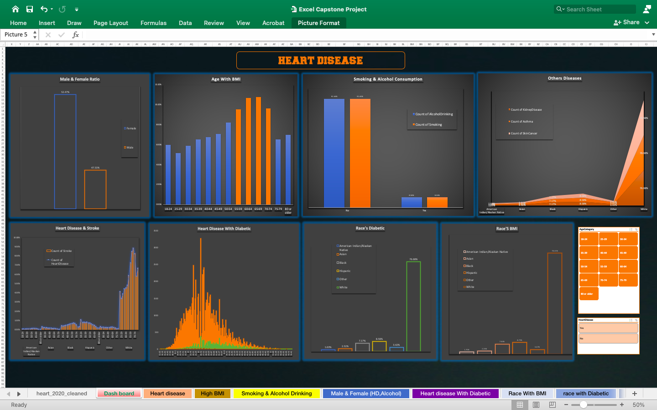

Slide 28
Video Link
https://youtu.be/feSFcajXoFg

